Slide 1
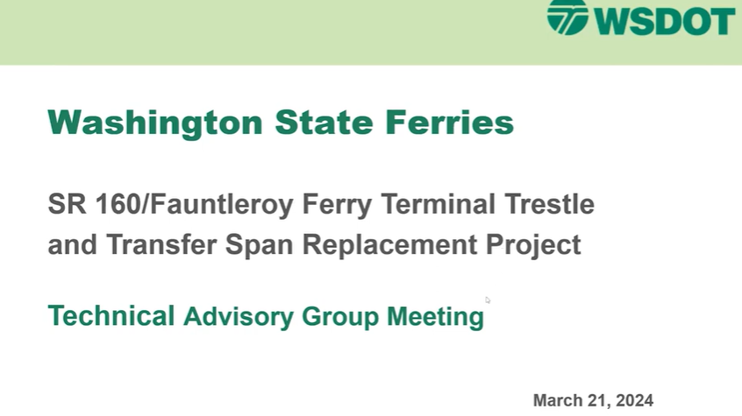

BASIC
COMMUNITY ADVISORY GROUP (CAG) = 5 YRS
Planning and Environmental Linkages (PEL)
PRESENTATION

Slide 2
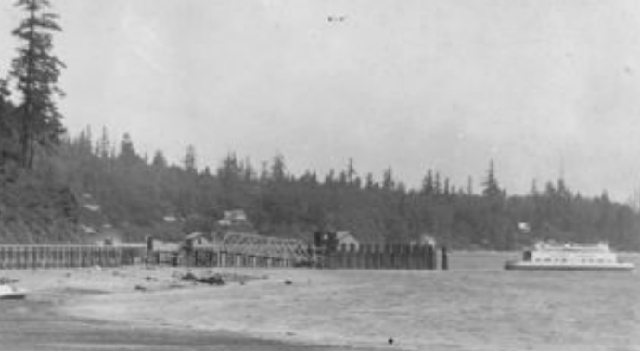
Vashon Portage Ferry terminal 1922
1921 Des Moines To Portage ferry
Start of “Marine Hwy” practice
Closed 1922

Slide 3
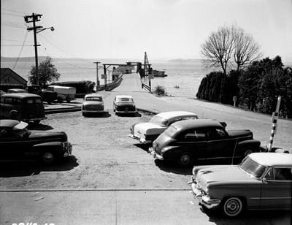
FAUNTLEROY Ferry terminal - 1922
Predated most Local Residents
Future Efficiency
Dwell time
Capacity
Dock holding

Slide 4
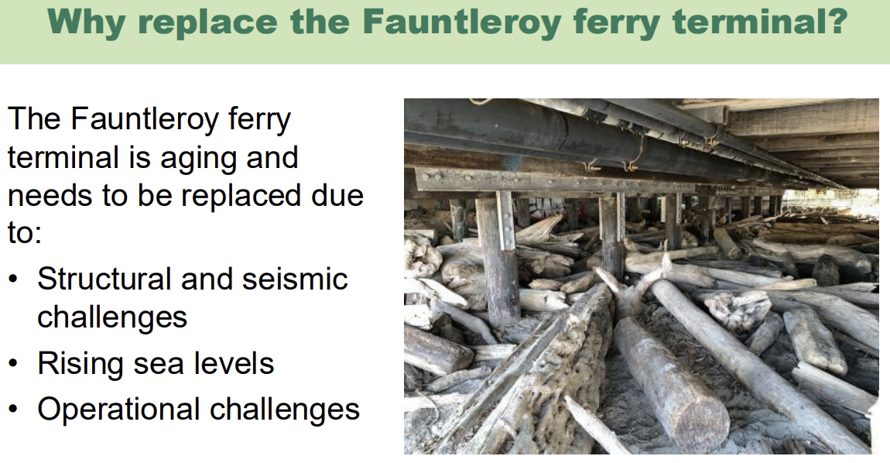

Overcoming
Nervousness

Slide 5
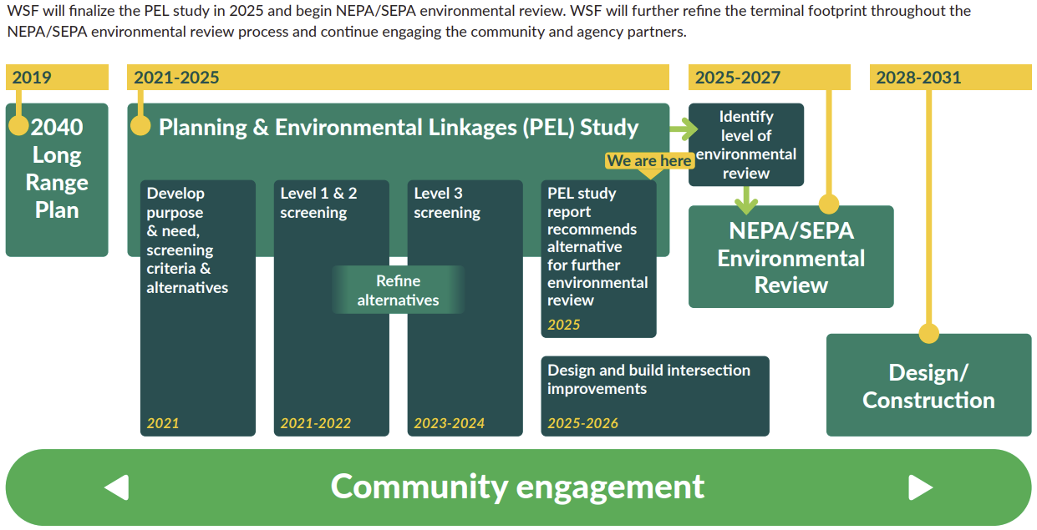
The Power of
PLANNING AND ENVIRONMENTAL LINKAGES (PEL)
Now
Communication

Slide 6
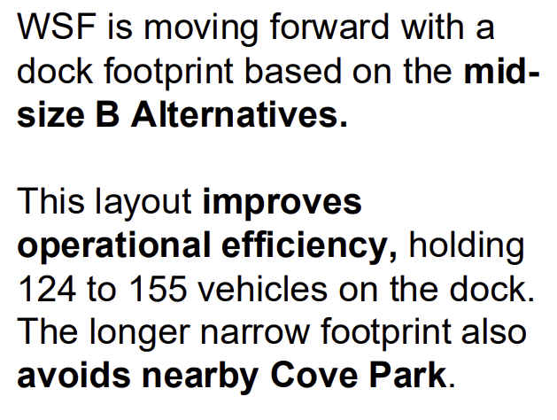
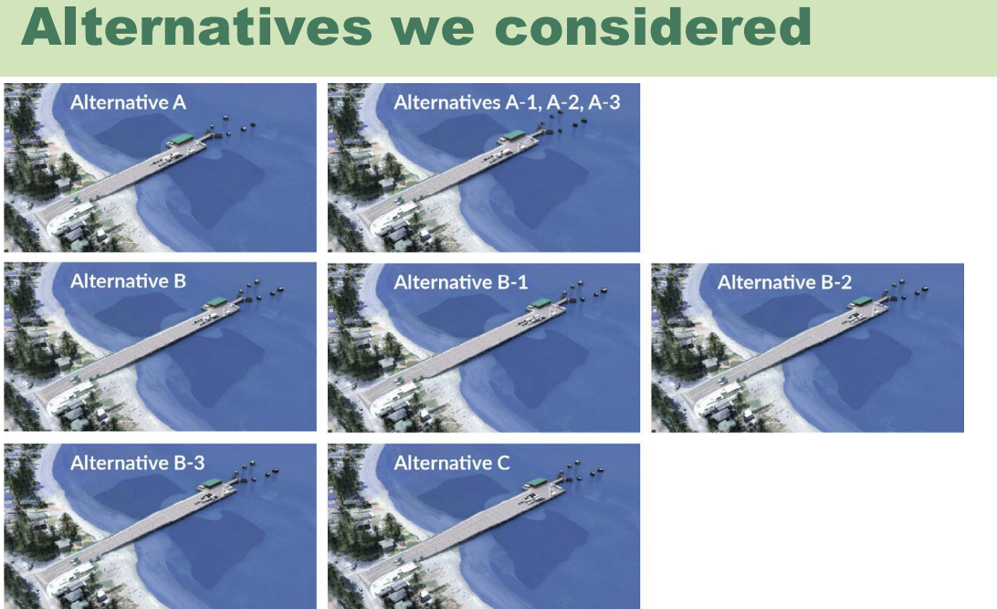
ENGAGING THE AUDIENCE
Make eye contact with your audience to create a sense of intimacy and involvement
Weave relatable stories into your presentation using narratives that make your message memorable and impactful
Encourage questions and provide thoughtful responses to enhance audience participation
Use live polls or surveys to gather audience opinions, promoting engagement and making sure the audience feel involved

Slide 7
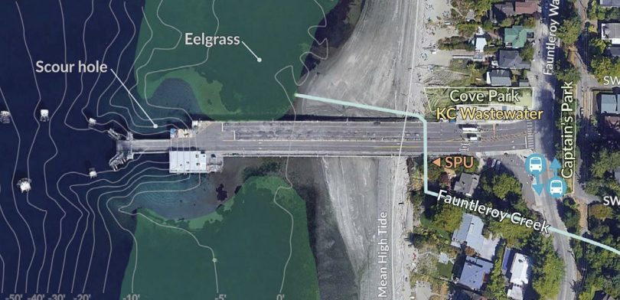
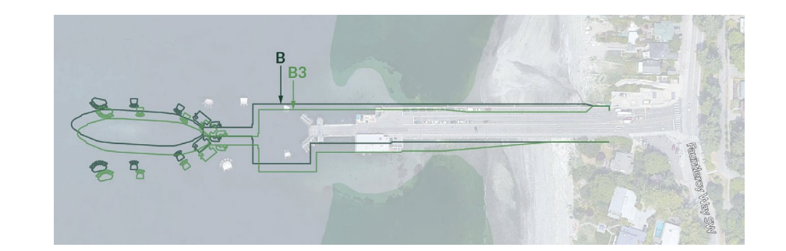
Section header
The current vehicle holding capacity of the Washington State Department of Transportation (.gov) Fauntleroy Ferry Terminal dock is approximately 80 to 90 vehicles. This capacity is significantly smaller than the 124-vehicle capacity of the Issaquah class ferries that serve the route, resulting in the need for queuing on adjacent streets.
Terminal Capacity: ~80-90 vehicles on the dock.
Vessel Capacity: 124 vehicles per Washington State Department of Transportation (.gov) Issaquah class boat.
Future Plan: A replacement project is in development, with selected designs aimed at expanding capacity to 124-155 vehicles on the dock.
Current
2031

Slide 8
Capacity
The current vehicle holding capacity of the Washington State Department of Transportation (.gov) Fauntleroy Ferry Terminal dock is approximately 80 to 90 vehicles. This capacity is significantly smaller than the 124-vehicle capacity of the Issaquah class ferries that serve the route, resulting in the need for queuing on adjacent streets.
Terminal Capacity: ~80-90 vehicles on the dock.
Vessel Capacity: 124 vehicles per Washington State Department of Transportation (.gov) Issaquah class boat.
Future Plan: A replacement project is in development, with selected designs aimed at expanding capacity to 124-155 vehicles on the dock.
The current vehicle holding capacity of the Washington State Department of Transportation (.gov) Fauntleroy Ferry Terminal dock is approximately 80 to 90 vehicles. This capacity is significantly smaller than the 124-vehicle capacity of the Issaquah class ferries that serve the route, resulting in the need for queuing on adjacent streets.
Terminal Capacity: ~80-90 vehicles on the dock.
Vessel Capacity: 124 vehicles per Washington State Department of Transportation (.gov) Issaquah class boat.
Future Plan: A replacement project is in development, with selected designs aimed at expanding capacity to 124-155 vehicles on the dock.
Terminal Capacity: ~ NOW 88 vehicles on the dock.
Future Vessel Capacity: = 124 vehicles per Washington State Department of Transportation (.gov) ( Issaquah class)
Future Plan: A replacement project is in development, with selected designs aimed at expanding capacity to 124-155 vehicles on the dock. ?
Consideration for future second dock?
? Bigger boats Jumbo = 188 , Jumbo Mark II = 202

Slide 9
Operational challenges - Over time
Fauntleroy 2026 2031 (2040) 2090 (next 50 yr)
Boat cap 124 car Max 188 – 202 ??? *
Dock Cap 84 cars 124 -186? Unknown
Ridership +37% SWorth ? *
+19% Vashon ? *
Sea Rise - as is + 3-12” +1.5 – 2.5
Fauntleroy dock height increase 2-3 ft tbd
* increased bus capacity

Slide 10
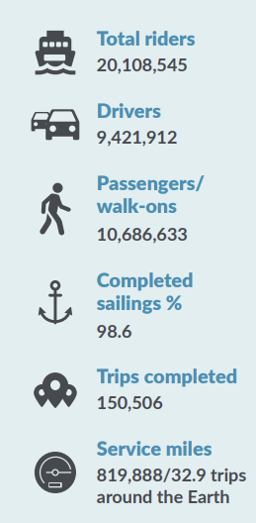
Faunt Future
2
0
2
5
Demand (Rider Walk on, Vehicle, Transit,
3 new E vessels 2030 160 -vehicles, hybrid-electric

Slide 11
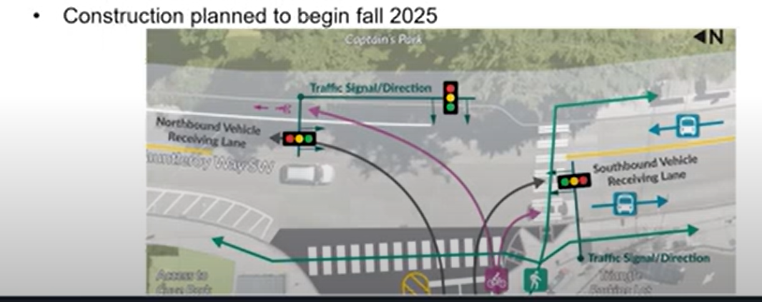
Intersection upgrade
SPRING 2026

Slide 12
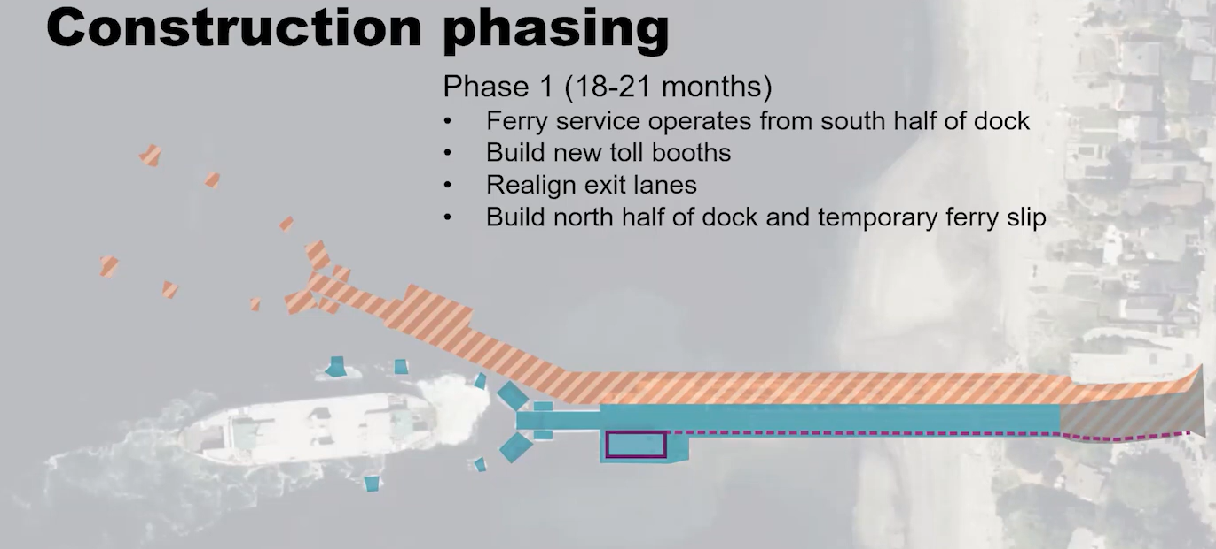
Construction 42 – 48 months Start 2028?
1

Slide 13
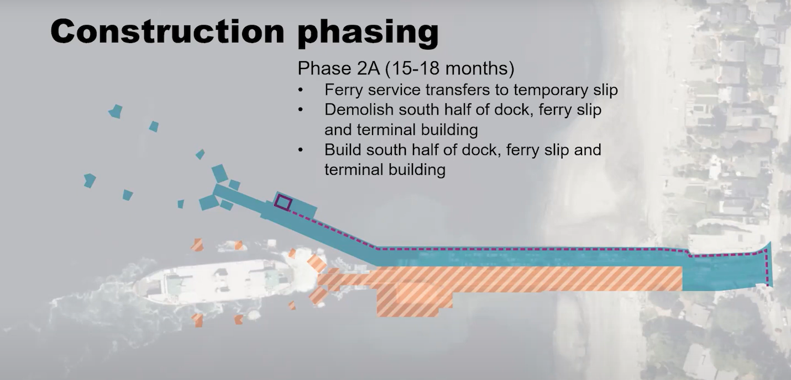
2A

Slide 14
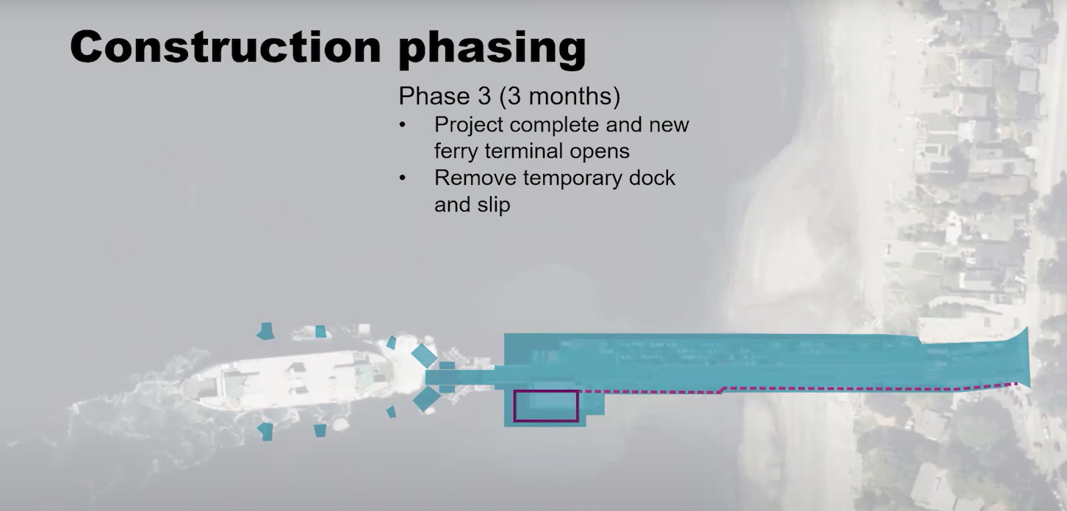
3

Slide 16
misc
Good to Go, Wave to G0
= drive through OK but - s l o w
- 30% increase in fare
- NOT AN OPTION ….
Passenger overhead loading
Not Feasible in this plan at this time

Slide 17
PARTNERS
2025-2027
ENVIRONMENTAL REVIEW
NEPA - National
Environmental
Policy Act
SEPA – State
Environmental Policy Act
Policy Act
Lead Agencies: WSF + FHWA
Local Agencies: The City of Seattle
Tribal Partners: Coordination is underway with local tribes, regarding treaty-reserved resources and cultural impacts.
Technical Consultants: WSP is acting as the General Engineering Consultant (GEC), with Nelson\Nygaard providing specialized support.

Slide 18
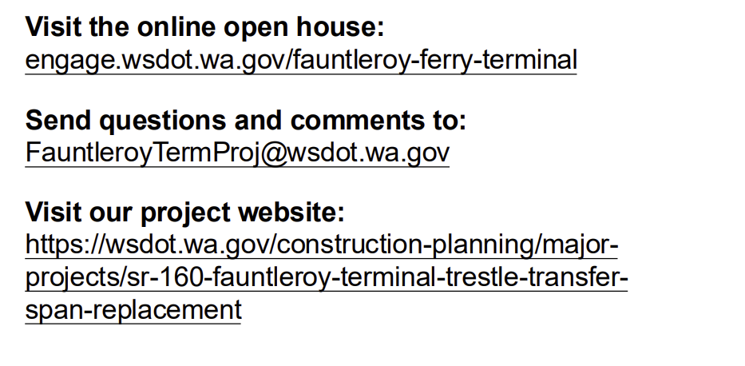
SPEAKING IMPACT
Your ability to communicate effectively will leave a lasting impact on your audience
Effectively communicating involves not only delivering a message but also resonating with the experiences, values, and emotions of those listening

Slide 19
FINAL TIPS & TAKEAWAYS
key key next steps involving the National Environmental Policy Act (NEPA) and State Environmental Policy Act (SEPA) reviews starting in 2025–2027 next steps involving the National Environmental Policy Act (NEPA) and State Environmental Policy Act (SEPA) reviews starting in 2025–2027
Consistent rehearsal
  Strengthen your familiarity
Refine delivery style
  Pacing, tone, and emphasis
Timing and transitions
  Aim for seamless, professional delivery
Practice audience
  Enlist colleagues to listen & provide feedback
Seek feedback
Reflect on performance
Explore new techniques
Set personal goals
Iterate and adapt

Slide 20
Vessel electrification
All electric by 2040
Terminal
Ferris
16 new electric = 165 car capacity
Mirjam Nilsson​
206-555-0146
mirjam@contoso.com
www.contoso.com

