Slide 1
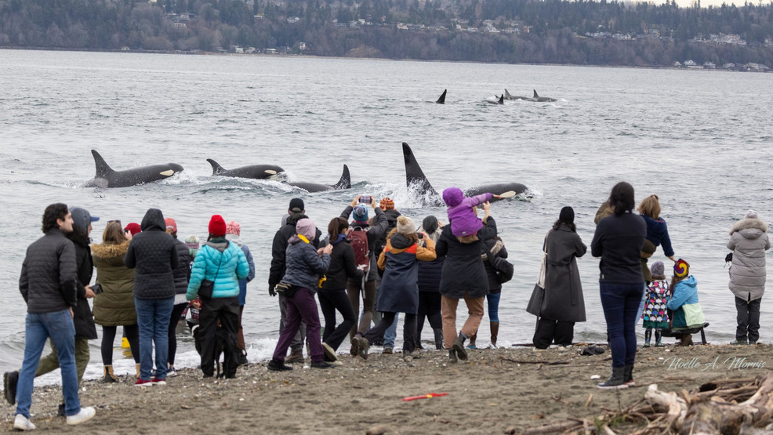
Nov/Dec 2025
Pt Robinson
Presenter: Theo Eicher
Notes:
This is a pix of Point Robinson Nov 2025

Slide 2
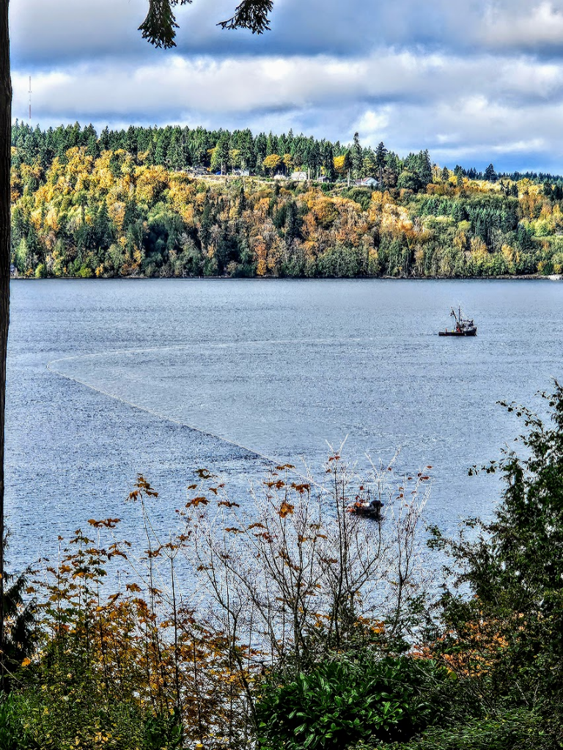
Nov/Dec 2025
Colvos Passage
Notes:
One day later(!), I took this picture of a commercial fishing vessel in Colvos passage. Sometimes they fish in pairs and line the entire passage with gill nets
This (Orcas visiting and fishermen fishing) highlights humans/orcas are competing for the same prey; -- it’s a delicate balance

Slide 3
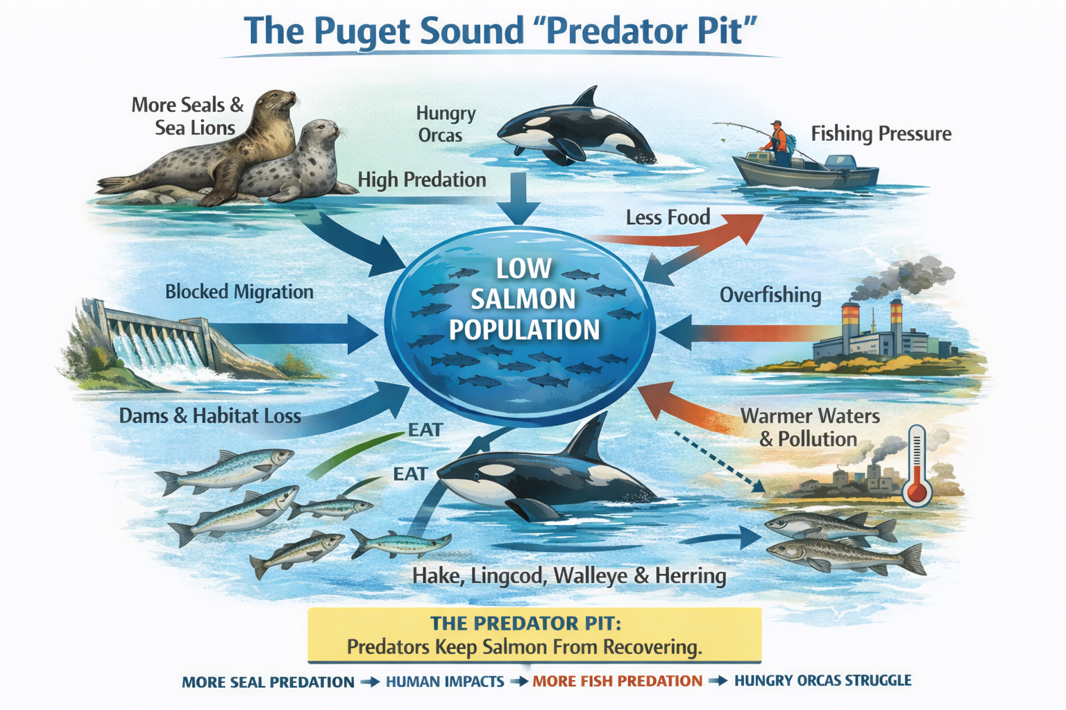
VII)
I)
VI)
V)
II)
IV)
III)
7 Major Sources Impacting Salmon Recovery
Notes:
But the situation is much more complex!
The Salish Sea Marine Survival Project labels Puget sound a “Predator Pit:
https://marinesurvivalproject.com/wp-content/uploads/FINAL-WORK-PLAN-PS-steelhead-marine-survival-31Jan2014.pdf
More than 7 different predatory forces influence salmon survival
Senate and House Memorial Bills seek to amend the Marine Mammal Protection Act
By eliminating one factor from the pit, it ignores the other 6

Slide 4
The House and Senate Memorial Bills
House Bill Report by House Committee’s own staffer, Rebecca Lewis (link)
  “More actions needed to support orca and salmon recovery, including removing fish passage barriers, addressing storm water, removing dams after mitigating the impact on people, reducing vessel noise, restoring wetlands, and reducing water pollution.”
  “Pinnipeds also eat fish that are salmon predators. Lethal management will cause predator fish to increase, resulting in the opposite of the desired effect.”
  “Washington State Academy of Sciences study is mischaracterized in the HJM.”
  “There is no clear scientific evidence that removing pinnipeds will have an outsized impact on salmon populations.”

Slide 5
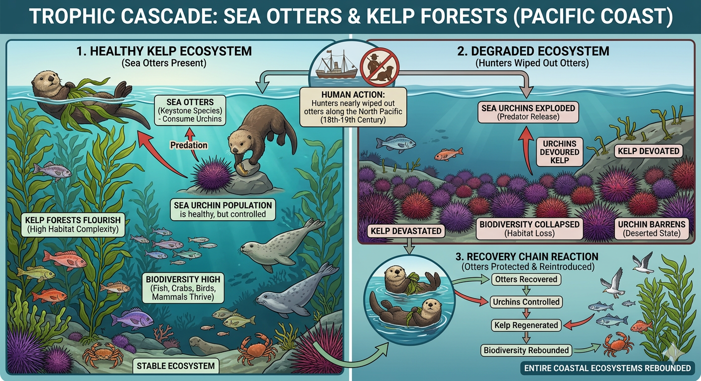
Human "Fixes" Often Unravel Food Chains
Example: PNW Otter Decimation Early 1900s
2. Sea Otters → Kelp Forests (Pacific Coast)
A classic ocean trophic cascade.
Human action:
Fur hunters nearly wiped out sea otters along the North Pacific.
Chain reaction
Sea urchins exploded
Urchins devoured kelp forests
Fish and marine biodiversity collapsed
When otters recovered:
Urchins controlled
Kelp forests regenerated
Fish, crabs and seabirds recovered
Entire coastal ecosystems rebounded

Slide 6
3 STUDIES
1) Salish Sea Marine Survival Project
2) Washington Academy of Sciences
3) Journal “Nature” study

Slide 7

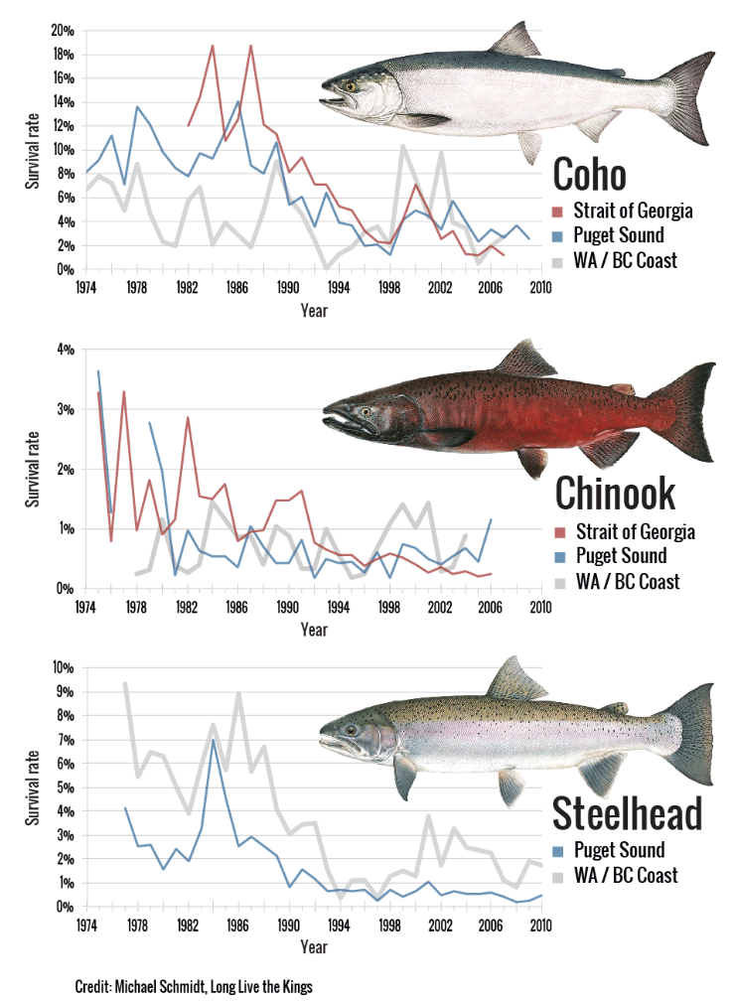
Constant Survival Rates (!?)
Since Mid 1990s As Seal Population Recovered
Encyclopedia of Puget Sound
“What is Killing Young Salmon?”
https://marinesurvivalproject.com/the-project/why/

Slide 8
  Washington State Academy of Sciences Study (Legislature Funded)
  (paraphrased, actual quotes in appendix)
  “Pinnipeds & salmonids exist within a greater ecological food web.”
  “Food Chain interactions affect A) the impact of pinniped predation on salmonids, and B) also affect the outcome of reducing pinnipeds on salmon.”
  “Increase in pinniped populations in Washington State since the enactment of the MMPA has likely influenced the structure of the entire ecosystem.”
  “Given the large number of food chain links … and the potential for direct and indirect ecological interactions, it is impossible to predict with certainty the outcomes for salmon & the rest of the food web where pinniped population size changed.” https://washacad.org/wp-content/uploads/2022/11/Pinniped-Predation-on-Salmonids-in-the-Washington-Portions-of-the-Salish-Sea-and-Outer-Coast-1.pdf

Slide 9
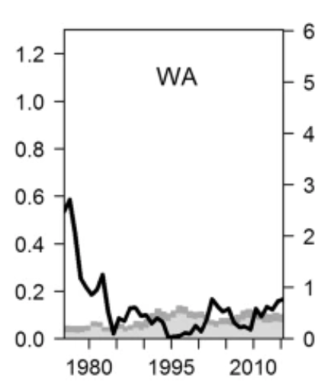
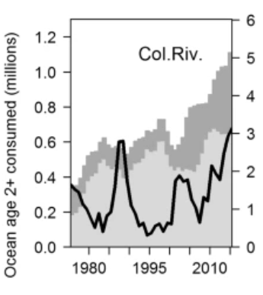
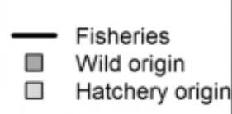
  Study in the Journal “Nature”
  Competing tradeoffs between increasing marine mammal predation and fisheries harvest of Chinook salmon
  “1975-2015 Chinook salmon stocks predation increased,
  But predation is presently near or below the fisheries harvest.”
Chinook Age 2+ (millions) Removed By Fisheries/ Predators
Columbia
River
https://www.nature.com/articles/s41598-017-14984-8
Notes:
Salmon originating from Washington are potentially consumed by marine mammals in Washington, British Columbia, and Alaska).

Slide 10
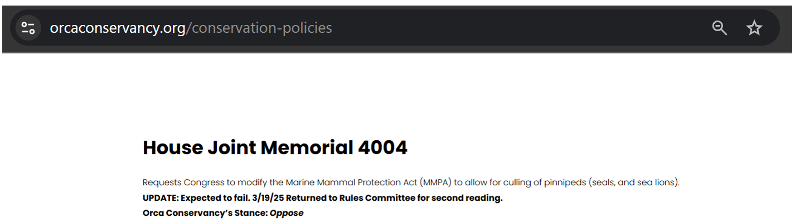
Thanks For Listening!
Reject
killing Pinnipeds as a “solution” to the salmon struggle
Science Says
killing pinnipeds may
not only
  NOT help salmon
  It may hurt salmon
  ➔ That’s why the Orca Conservancy opposes both bills.
https://www.orcaconservancy.org/conservation-policies
Notes:
Altering the MMPA to reduce protections for certain marine mammals could disrupt the natural balance of marine ecosystems. Predation is a natural process, and reducing predator populations may have unforeseen consequences on the food web, potentially affecting other species, including salmon.
Pinnipeds don’t just eat salmon—they also eat fish that prey on salmon. Pinnipeds are “generalist” predators and prey on a variety of species including invasive species and other predators of salmon. Some fish species pinnipeds help to manage include: Pacific Hake, Spiny Dogfish, Lingcod, Cabezon, Rockfish, and Northern Pike (invasive), which all prey on salmon and juvenile salmon.
There is limited scientific evidence to conclusively demonstrate that reducing pinniped populations will lead to significant improvements in salmon numbers. Focusing on predator control may divert attention and resources from addressing primary factors affecting salmon recovery, such as habitat degradation, water quality, and overfishing.
Transient orcas, also called BIgg’s killer whales, another ecotype present in Washington waters, prey on marine mammals, including seals and sea lions. Reducing pinniped numbers could decrease the prey available to transient orcas, potentially impacting their health and survival. Studies have not been conducted to understand how reducing pinnipeds could impact mammal-eating orcas.
Modifying the MMPA without thorough scientific studies on the potential impacts could lead to unintended ecological consequences. It is essential to understand the complex interactions between species before implementing policies that could alter these dynamics.

Slide 11
Supplemental Information
Notes:
Altering the MMPA to reduce protections for certain marine mammals could disrupt the natural balance of marine ecosystems. Predation is a natural process, and reducing predator populations may have unforeseen consequences on the food web, potentially affecting other species, including salmon.
Pinnipeds don’t just eat salmon—they also eat fish that prey on salmon. Pinnipeds are “generalist” predators and prey on a variety of species including invasive species and other predators of salmon. Some fish species pinnipeds help to manage include: Pacific Hake, Spiny Dogfish, Lingcod, Cabezon, Rockfish, and Northern Pike (invasive), which all prey on salmon and juvenile salmon.
There is limited scientific evidence to conclusively demonstrate that reducing pinniped populations will lead to significant improvements in salmon numbers. Focusing on predator control may divert attention and resources from addressing primary factors affecting salmon recovery, such as habitat degradation, water quality, and overfishing.
Transient orcas, also called BIgg’s killer whales, another ecotype present in Washington waters, prey on marine mammals, including seals and sea lions. Reducing pinniped numbers could decrease the prey available to transient orcas, potentially impacting their health and survival. Studies have not been conducted to understand how reducing pinnipeds could impact mammal-eating orcas.
Modifying the MMPA without thorough scientific studies on the potential impacts could lead to unintended ecological consequences. It is essential to understand the complex interactions between species before implementing policies that could alter these dynamics.

Slide 12
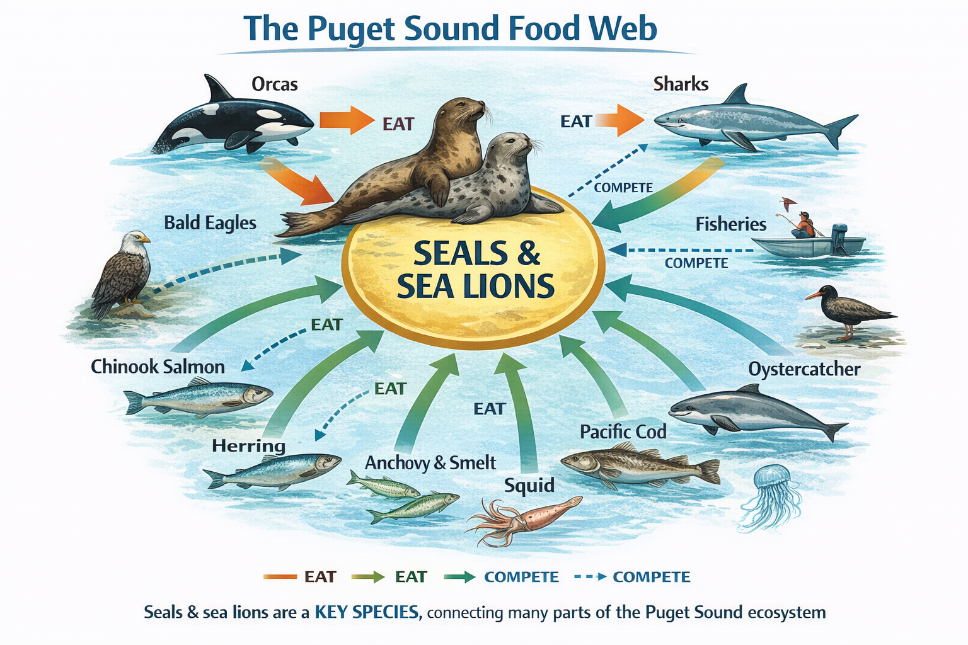

Slide 13
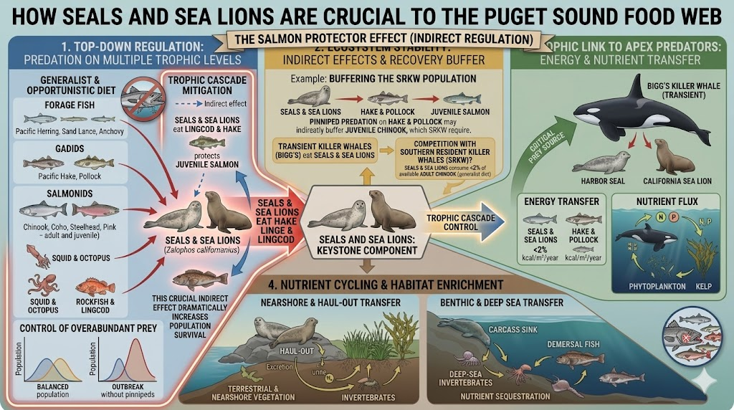

Slide 14
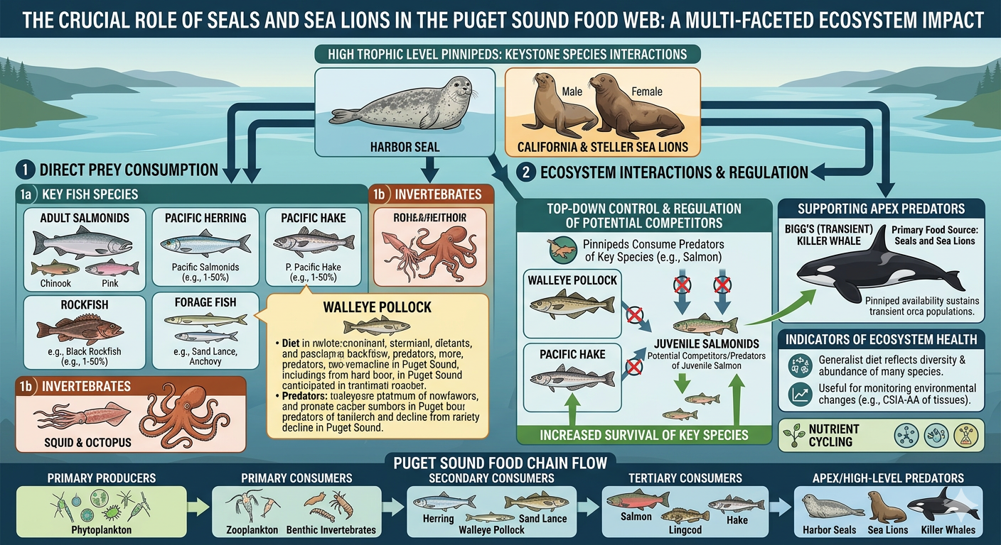

Slide 15
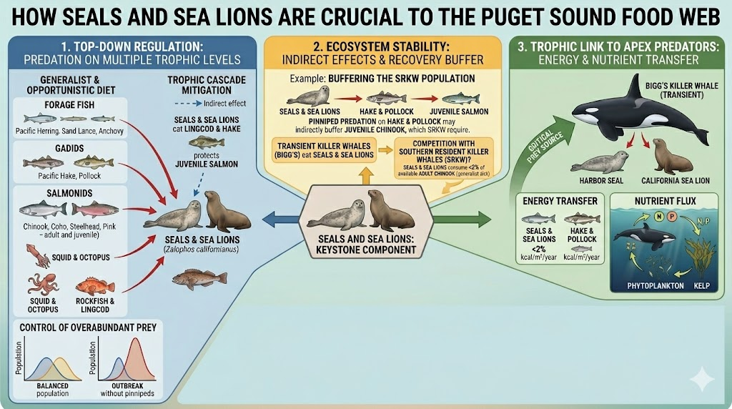

Slide 17
Legislature Funded
Washington State Academy of Sciences Study (link)
  Executive Summary
  “Trophic interactions involving pinnipeds and salmonids in the Salish Sea… and Outer Coast are numerous and complex.“
  “Pinnipeds & salmonids exist within a greater ecological context and food web”
  “Many of those trophic interactions have the potential to either mediate the impact of pinniped predation on salmonids or affect the outcome of management actions aimed at reducing pinniped predation on salmon.”
  “Increase in pinniped populations in Washington State since the enactment of the MMPA has likely influenced the structure of the entire ecosystem.”
  “Given the large number of trophic links between pinnipeds and salmonids and the potential for direct and indirect ecological interactions, it is impossible to predict with certainty the outcomes for salmon and the rest of the food web under scenarios where the pinniped population size is changed. ”

